Slide 1

From Utopia
To Reality
The hidden challenges of E.D.A.
hand-out
Ruben Scheedler

Slide 2
The technical landscape
The garden of E.D.A. (event-driven architecture)

Slide 3
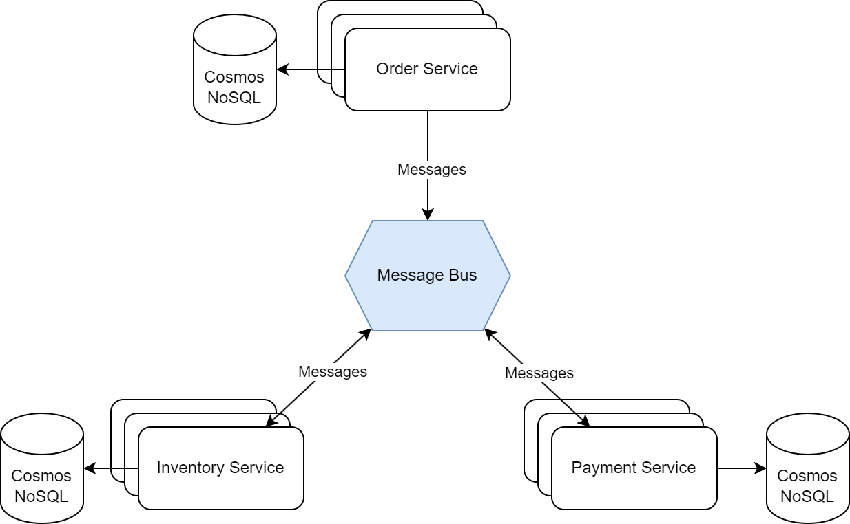


Slide 4
What makes this landscape so awesome?
Cloud: not bounded by on-prem limitations. Great for scaling, but also for availability.
Microservices: Scalable, isolated failures (in theory at least), independent development process per team, encapsulation of data and behavior. Clear boundaries and good compartmentalization.
Cosmos NoSQL: More scalability! We accept eventual consistency and in return we can create partitions and be highly available.
Event-Driven Architecture: Communication via messages using a message bus decouples producers from consumers (no cascading failures), allows for work to be divided over multiple instances and makes sure actions (messages) are never lost.

Slide 5
Dealing with out of order messages
(Time travellers)

Slide 6
Strategy 1: Retry
Retrying means sending the message to the back of the queue again, from which it will be picked up when the rest of the queue is processed and when a consumer is available.
It is a good option when you are dealing with:
  Technical issues temporary in nature (503 of a service, network hiccup, etc)
  race conditions: if a message is processed too early, you can leverage retrying to wait for the other message(s)

Slide 7
Strategy 2: Logging an exception
Note: by this I mean logging the exception and considering the message as handled.
Use this strategy when you would typically throw an exception: when you can’t handle the message like you want to.
It is a viable option if retrying (now or far in the future) is not an option or pointless.
To decide between ignoring the message and logging an exception answer the question: do I want to be notified as maintainer of the system or would that just be noise to be ignored?

Slide 8
Strategy 3: Ignoring the message
Similar to strategy two: used when you cannot handle the message like you want to, bút you do not really care. You are happy with the state of the system as it is and consider the message as processed without doing anything.
A second situation where this strategy might apply is for example when processing telemetry data. Especially for very high volumes you could ignore the message to not put extra strain of the system in the form of retries. In return, you might have slightly less accuracy in metrics due to a sample being lost, but this might be perfectly acceptable.

Slide 9
Strategy 4: Handling the message anyway, somehow
Applies to a situation that would typically yield an exception in a traditional system, but with some creativity you can work around it.
The example in the my presentation was to create a reservation while a table to it, even though the reservation should technically exist.
This strategy can conflict with domain logic so requires careful trade-offs.
Can be useful when performance is paramount and you cannot afford the strain on the system of retrying messages.

Slide 10
Strategy 5: Move the message to a dead letter queue
A dead letter queue (DLQ) is a special queue where unprocessable messages can be sent to.
This strategy is related to retrying the messages, but allows you to:
  Investigate the message manually
  Retry the message when you think the time is right. Maybe after rolling out a hotfix or when you know another message has been processed on which this one is dependent.
Note that there might be a retention time configured on the DLQ so you could still lose the message.

Slide 11
Dealing with large messages
(Giants)

Slide 12
Three remedies that fix many problems w.r.t. large messages
Configuration
Claim-Check Pattern
Concurrency Control

Slide 13
Configuration
Check the size limits of messages of your messaging bus
Specifically for Azure: beware their are different tiers with different limits
If you are saving messages in the database (for outbox, event sourcing, etc) check the limits of your database.

Slide 14
Do not send the entire message: claim-check pattern
Claim Check - Enterprise Integration Patterns
Save a part of the message in a data store accessible by the producer and the consumer. Store it before sending and retrieve it when handling it in the consumer.

Slide 15
Concurrency
Leveraging your scalable event-driven system requires you to split up your large message into smaller units of work.
The consequence of doing so is that a lot of messages, that are typically related as well, are processed at the same time.
The risk of race conditions increases with that so take this into consideration when writing the processing of the smaller units of work.
Reduce shared resources (bottleneck) during processing of units of work.

Slide 16
EDA: A powerful dragon, but hard to tame
EDA is a powerful enabler for scalable, available and resilient systems
Bút, it comes with tough challenges that you might have never encountered in more traditional systems
In you decide to adopt EDA be prepared! And do not assume it will be a walk in the park.

